Slide 1
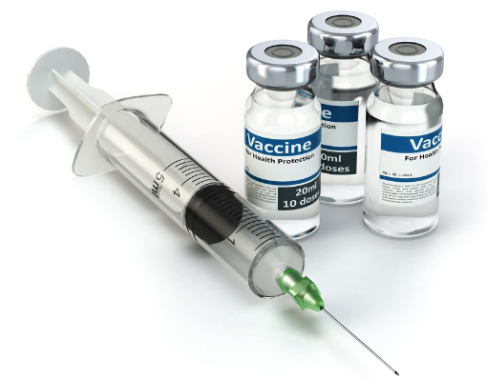
Vaccines
Chapter 7 Human Perspectives

Slide 2
Date: | Human Biology Year 12 ATAR
Do Now Get out your stuff, ready to start! Lesson Agenda 1: Do Now 2: Vaccines 3: Review Worksheet Suggested Study Complete review worksheet, mark and correct using answer key on Connect. Read through today’s notes and textbook section NEXT LESSON Past Exam Question Vaccination and Specific Immunity | Learning Aims Define vaccination and immunisation List and describe ingredient types in vaccines List types of vaccine based on their active ingredient Discuss the main types of vaccine including information about How they work How they are made Pros and Cons Examples Describe modes of vaccine delivery Discuss immune response after first and second vaccination and why boosters are sometimes required. Discuss benefits and risks of vaccines Discuss how vaccination programs affect human health Explain “herd” immunity and why it is important Outline some reasons why people may not choose to vaccinate.
 | Key Vocabulary Antigen Antibody Vaccine Immunisation Toxoid

Slide 3
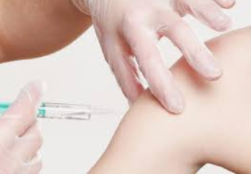
Vaccination
Is the artificial introduction of antigen to provoke antibody-mediated immunity to a pathogen without causing disease.
Controlled first and second exposure to an antigen or pathogen via artificial methods.
Vaccination = the process of getting the vaccine – usually leads to
immune response.
Immunisation = the immune response to the vaccine
Vaccines come in different forms
Different ways they work
Different ways they are given
Learning Aim: Define vaccination and immunisation

Slide 4

What’s in the bottle?
Active ingredient – the antigen that causes the immune response.
Adjuvants – substances that assist the immune response to the antigen.
Stabilisers and Preservatives – stop the vaccine from deteriorating.
Antibiotics – prevent bacterial contamination during vaccine manufacture (only present in tiny amounts in the vaccine bottle).
Saline solution – to dissolve everything. This is often added just prior to injection.
*Note – all vaccines are subjected to rigorous trials and testing before use in humans
Learning Aim: List and describe the ingredients in vaccines

Slide 5
Vaccines – 4 types of active ingredient
Different vaccines have different active ingredients. The antigenic site on the pathogen is processed in different ways so it doesn’t cause disease but still provokes antibody-mediated immunity, depending on the pathogen involved:
Live Attenuated
Inactivated (Killed)
Toxoid
Subunit
Nucleic Acid Vaccines (eg mRNA vaccine)* not currently in curriculum as very new, but is important as Covid-19 vaccines are this type.
Learning Aim: List the main types of vaccine

Slide 6
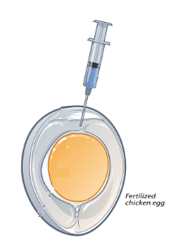
Live Attenuated Vaccines
Vaccine made from live pathogens that are recognised by the immune system but are too weak to cause disease.
How is the organism weakened?
Pathogen grown in a series of chick embryos in eggs. The pathogen replicates in one embryo, then is transferred to the next, in series.
As the series progresses, the pathogen becomes more adapted to chicken cells and less adapted to human cells.
By the end of the series, the pathogen is too weak to infect human cells but the human immune system can still recognise it. It takes around 10 years for the pathogen to become weakened.
Examples of Live Attenuated Vaccines
Bacteria: Tuberculosis (BCG)
Virus Oral Polio Vaccine (OPV) Measles, Mumps, Rubella Rotavirus
Note: these vaccines have a very small risk of reverting to their original form and causing disease.
Learning Aim: Discuss the main types of vaccine including information on how they work, how they are made, pros and cons, and examples .

Slide 7
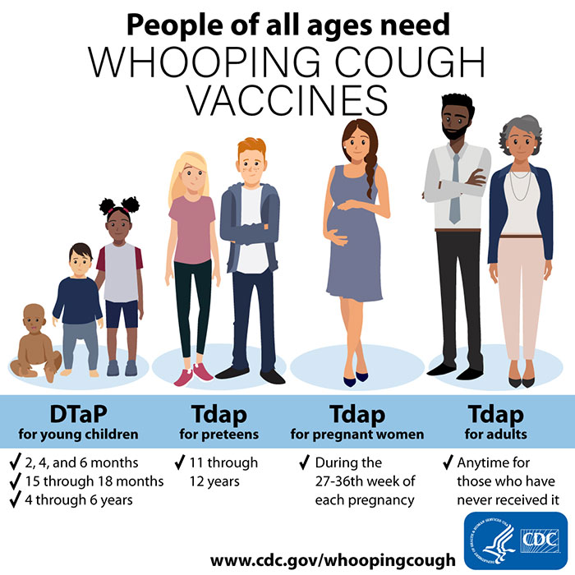
Inactivated (Killed) Vaccines
Vaccine made from killed pathogens that can’t reproduce but can still be recognised by the immune system.
Killed using heat or chemicals.
Shorter length of protection than live attenuated, but can’t revert back and cause disease.
Examples of Inactivated (Killed) Vaccines
Virus: Influenza (injected) Pertussis (whooping cough) Inactivated (acellular) Polio (injected) Rabies
Learning Aim: Discuss the main types of vaccine including information on how they work, how they are made, pros and cons, and examples .

Slide 8
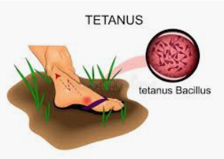
Toxoid Vaccines
For diseases where the pathogen causes disease by producing a toxin.
Eg: the tetanus bacterium produces a neurotoxin that paralyses muscles, causing pain and death.
Created by inactivating the toxin so the antigenic site is still present, but the toxin no longer works, using heat or chemicals.
Examples of Toxoid Vaccines
Bacteria: Tetanus Diphtheria
Note: a toxoid vaccine is not the same thing as an antitoxin.
An antitoxin contains premade antibodies that neutralise the toxin (similar to antivenom), and is given once infection occurs. No lasting immunity is provided from antitoxin
Learning Aim: Discuss the main types of vaccine including information on how they work, how they are made, pros and cons, and examples .

Slide 9
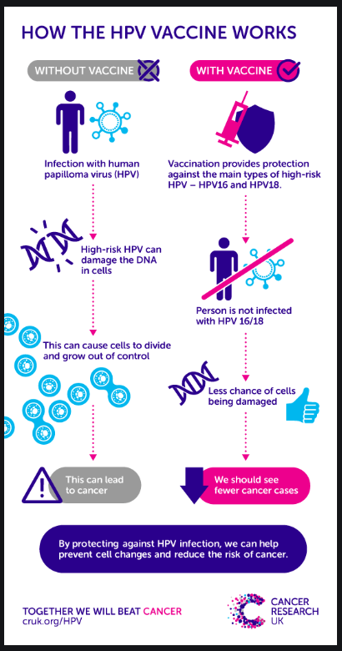
Subunit and Conjugate Vaccines
Use only part of the pathogen to provoke the immune response.
Can be done several ways
Isolating the antigenic protein and just using that.
Using recombinant DNA technology to insert the antigenic protein into a harmless virus, or cells in culture so the antigen is presented/produced.
Examples of Subunit Vaccines
Virus: Human Papillomavirus Hepatitis B Some influenza vaccines Some pertussis (whooping cough) vaccines
Learning Aim: Discuss the main types of vaccine including information on how they work, how they are made, pros and cons, and examples .

Slide 10
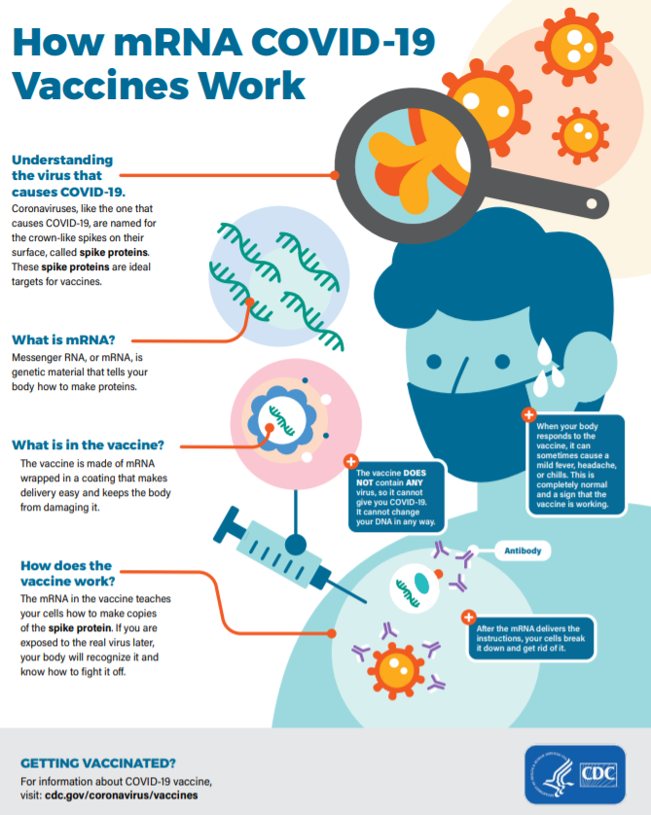
Nucleic Acid (eg mRNA) Vaccines*
Introduce mRNA into the body which is absorbed by cells and then codes for production of the antigen, which then triggers the immune response.
1: mRNA introduced via vaccine
2: mRNA enters cells and is in cytoplasm
3: mRNA gives instructions to cell to make the antigenic protein (for Covid-19 this is a protein spike on the surface of the virus)
4: antigen produced and presented
5: immune system recognises antigen as foreign and produces antibody-mediated immunity.
Examples of Nucleic Acid Vaccines
Virus: Covid-19 Vaccines
*Note – this is not currently in the Human Biology curriculum but is important and topical.
Learning Aim: Discuss the main types of vaccine including information on how they work, how they are made, pros and cons, and examples .

Slide 11
Summary of Vaccine Types
Type of Vaccine | How it works | Manufacture | Pros | Cons | Vaccines of this type
Live Attenuated | Live, but weak Too weak to cause disease Still provoke immune response to provide long-term, specific immunity | Virus passed through a series of cell cultures Up to 200 times Often chick embryos Virus adapts to chicken cells, but loses ability to cause disease in human cells Virus then used to produce vaccine | Longer lasting immunity than other vaccine types | Can sometimes (very rarely) revert and cause disease | Measles Mumps Rubella (German Measles) Varicella (Chicken Pox) Oral Polio Vaccine Rotavirus
Killed/Inactivated | Pathogen killed /inactivated by heat or chemicals Can no longer cause disease Retains antigenic sites so still provokes immune response “Killed” – bacteria “Inactivated” - viruses | Pathogen inactivated/killed by heat or chemicals and then used to manufacture vaccine | Cannot cause disease – it’s dead. | Shorter duration of immunity than live vaccines – needs more boosters. | Pertussis (Whooping Cough) Inactivated Polio Vaccine Typhoid Some Influenza Vaccines
Toxoid | Works to stimulate immunity to a toxin produced by the pathogen | Toxin inactivated by heat or chemicals, but still retains antigenic sites so can still provoke an immune response but not damage the body | Protects from diseases where toxins are produced |  | Tetanus Diphtheria
Subunit/Conjugate | Use part of pathogen containing antigenic site rather than whole pathogen | Gene coding for antigenic site inserted into harmless virus, used to make vaccine Or part of pathogen isolated to make vaccine | Cannot cause disease – it’s not the whole pathogen |  | Acellular Pertussis (whooping cough) Human Papilloma Virus (HPV) Pneumococcal Hepatitis B
Nucleic Acid (mRNA) *not in current curriculum | mRNA coding for antigenic protein is injected and absorbed into body cells which then manufacture the antigenic protein (not the whole virus). | mRNA isolated from virus, packaged and injected. | Cannot cause disease – it’s only part of the pathogenic mRNA |  | Covid-19 vaccines

Slide 12
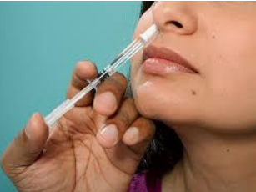
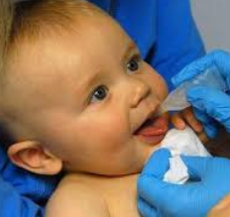
Vaccine Delivery
Commonly via injection
Under skin
Into muscle
Not into bloodstream
Sometimes orally or via nasal spray
“Flumist”
Polio, Rotavirus
Current research into
Incorporation into foods
Skin patch
Learning Aim: List modes of vaccine delivery .

Slide 13
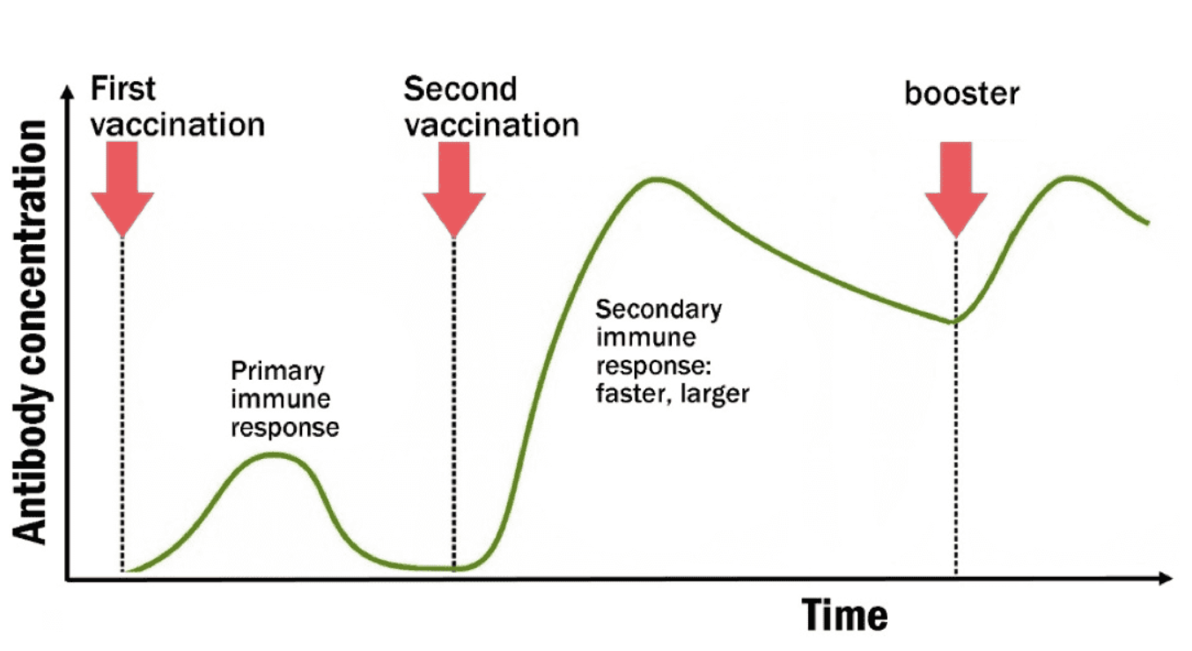
Vaccines and Boosters
Immunity decreases over time after vaccination.
The first response is quite short-term.
Two vaccines are often given within a short timeframe (usually a few months) to stimulate the primary and then secondary immune response (see previous notes on anti-body mediated immunity).
Booster vaccines may need to be given much later as immunity decreases.
Some vaccines require boosters more often than others:
Inactivated and Toxoid vaccines need more frequent boosters
Eg: Whooping cough and Tetanus vaccines
Learning Aim: Discuss immune response after first and second vaccination and why boosters are sometimes needed later.

Slide 14
Benefits and Risks of Vaccines
Vaccines are one of the most important advances in human health. They are:
Relatively Cheap
Preventing disease via vaccination is far cheaper for individuals and communities than treating disease once it occurs.
Effective
Different vaccines vary in effectiveness, but in general are very effective
Measles vaccine 97% effective (one of the most effective)
Whooping cough vaccine 70-80% effective
Safe
Mild, local reactions (eg redness and pain) are fairly common, but chance of a serious, life-altering reaction is 1 in 1 million, less than being struck by lightning. ☺
Some people may be allergic to trace components in the vaccine, for example egg protein. This is why they ask you to stay for 15 minutes after a vaccine is given, so they can treat an allergy quickly if it occurs.
Learning Aim: Discuss benefits and risks of vaccines

Slide 15
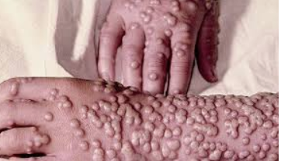
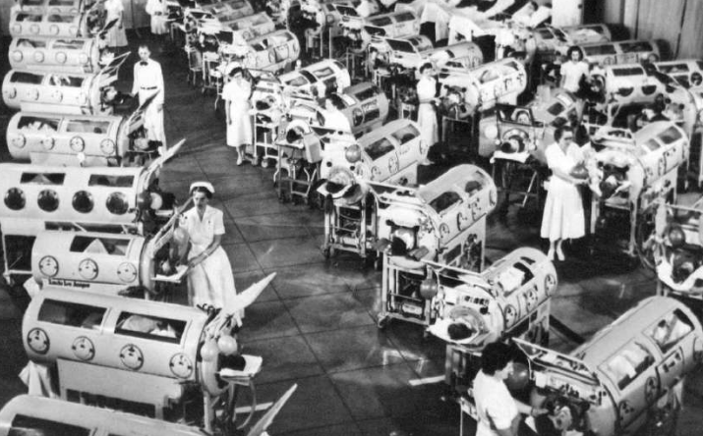
Vaccination and Population Health
Introduction of vaccines has had one of the largest positive impacts on population health.
Some diseases have been completely eradicated
Smallpox
Some diseases have been almost eradicated
Polio
Vaccination of most of the population is important
to protect those who cannot be vaccinated for
medical reasons (eg allergy). Herd Immunity
refers to the protection offered when almost
everyone is vaccinated.
Learning Aim: Discuss how vaccination programs affect human health.

Slide 16
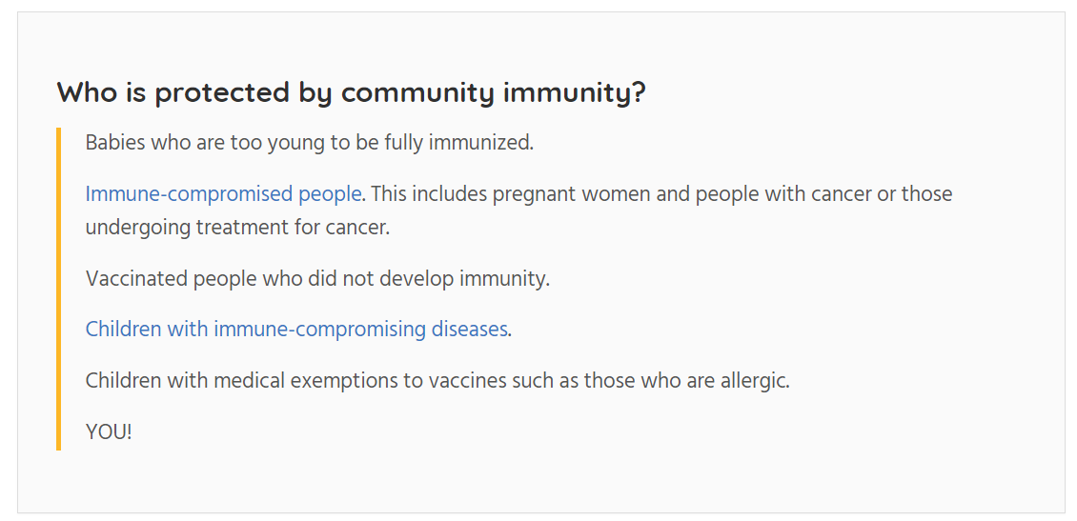
Vaccines and Herd (Community) Immunity
Protects people in the community who are unable to be vaccinated, or are immunosuppressed.
If enough people in the population are vaccinated and immune, disease can’t spread: the vaccinated people are a barrier or shield that prevents disease spreading through the community effectively.
Learning Aim: Explain “herd immunity” and why it is important.

Slide 17
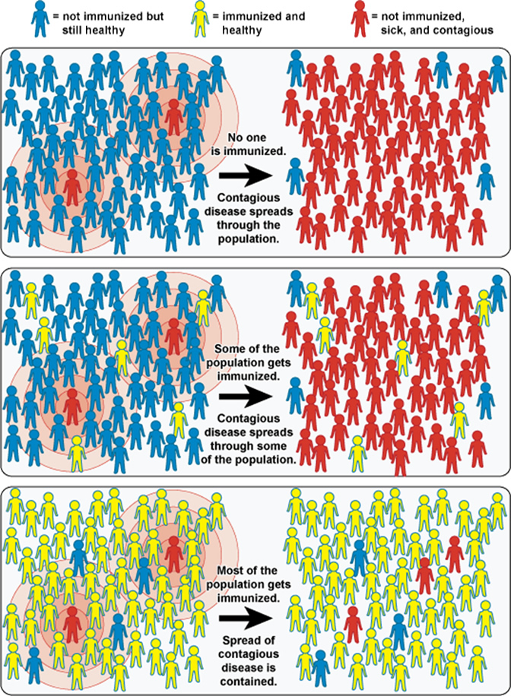

Herd Immunity

Slide 18
Vaccines – Decision Making, Information and Misinformation
Herd immunity requires large numbers of people to be vaccinated to protect those who are allergic, or immunocompromised.
Some people choose not to vaccinate even though they don’t have an allergy or religious reason not to vaccinate.
There is substantial misinformation about vaccination, especially online and on social media.
Factors that affect a person’s viewpoint and decisions on vaccines include:
Inability to be vaccinated due to allergy
People with allergies to a vaccine can’t be vaccinated but usually support vaccination as it provides herd immunity that protects them.
Misinformation
People exposed to incorrect (but often frightening and convincingly presented) information about vaccines may fear the vaccine ingredients. Eg: myth that vaccines cause Sudden Infant Death Syndrome – there is no evidence to support this.
Ethical Concerns
Use of animals to produce vaccines (eg chick embryos) or for vaccine testing.
Use of human tissue in some (not all) vaccines – eg Rubella vaccine is grown in a cell culture originally derived from miscarried foetal tissue
Informed consent – some people worry that there is not enough informed consent during clinical trials. This is less of a problem now, but medical testing has not always been ethical.
Concerns about HPV vaccine promoting sexual activity in teens (what do you think about this?)
Availability – vaccines may not be available in some areas, or may be too expensive for some populations.
Religious beliefs – some people say they can’t be vaccinated for religious reasons. The major religious groups in Australia support vaccination but there are some small religious groups who do not.
Economic factors – some people think that vaccines are promoted unethically because drug companies will make a profit. There isn’t good evidence to support this.
Learning Aim: Outline some reasons people may choose not to vaccinate.

Slide 19
Some things to consider when you are thinking about vaccination and public health…
There is a huge amount of good quality, scientific research to support the view that vaccination is safe and effective. Given that the evidence supports safety and efficacy of vaccines:
Do people have a social responsibility to vaccinate to protect others? Why or why not?
Should vaccination be made compulsory by government? Why or why not? How can people be encouraged to vaccinate?
How should misinformation about vaccination be dealt with?

